Slide 1
Tympe: Timed Typing
CSSIx 2019 final project
Front End Developers: Daniel Marin & Sonny Pizzo
Back End Developers: Logan Schlick & Kyle Rimandoz
Advisor: Shane Ghuste

Slide 2

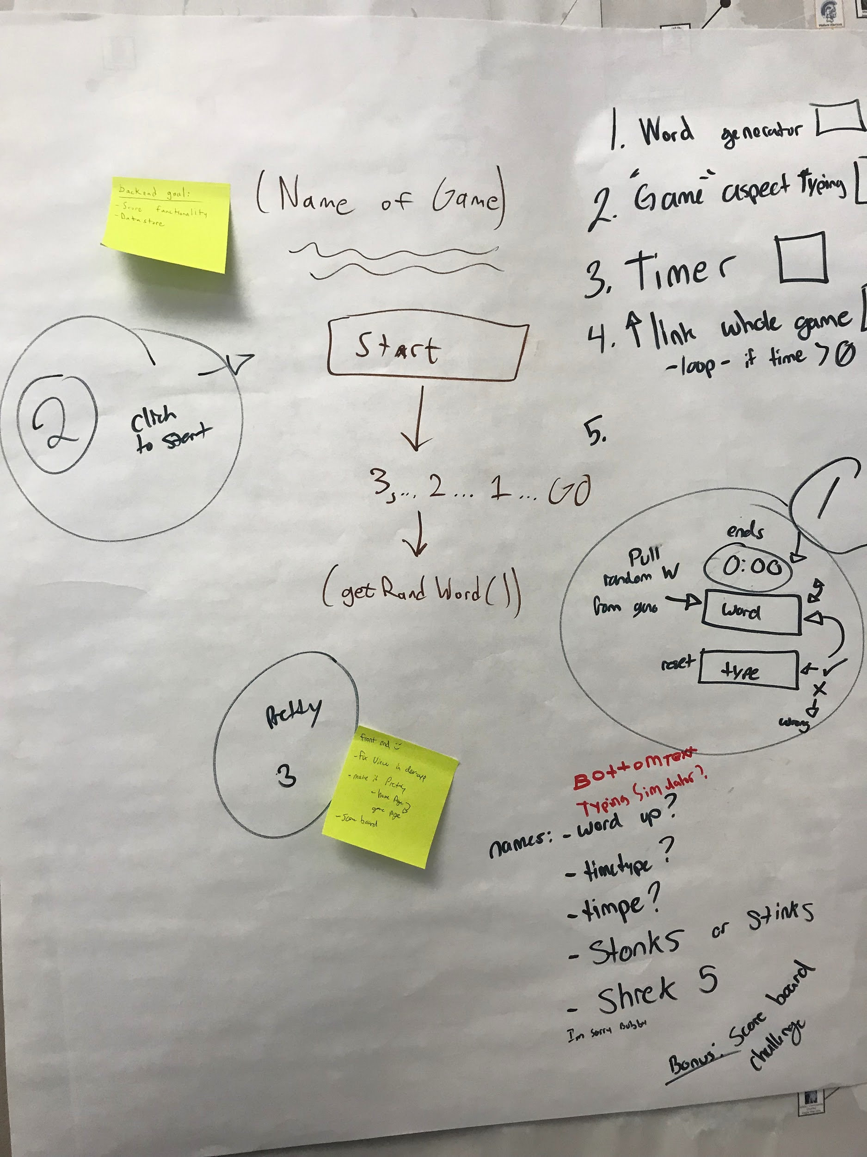
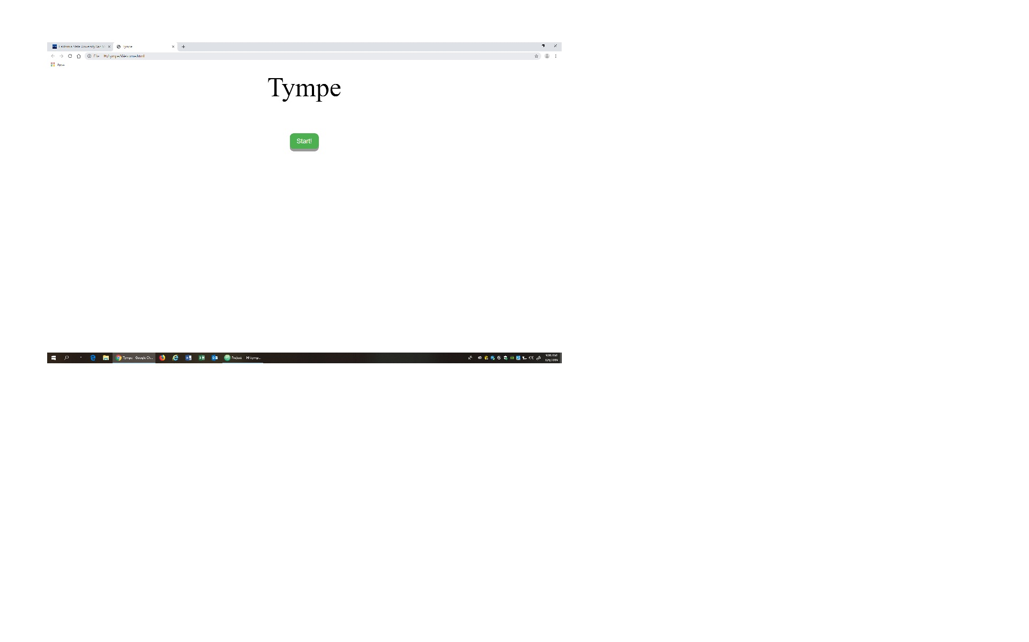
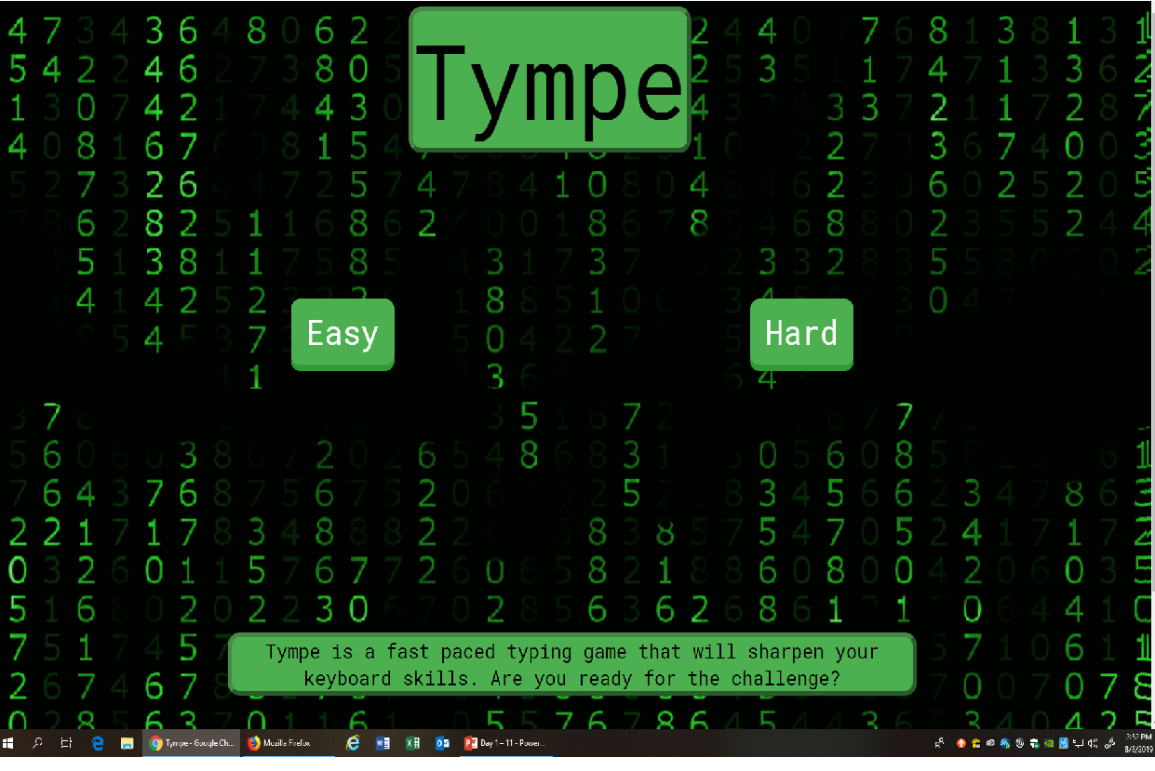
What is Tympe?
Tympe is a word typing game developed to sharpen your keyboard skills through a timed challenge.
Easy mode - basic computer users
Hard mode - implements coding language directed toward CS

Slide 3
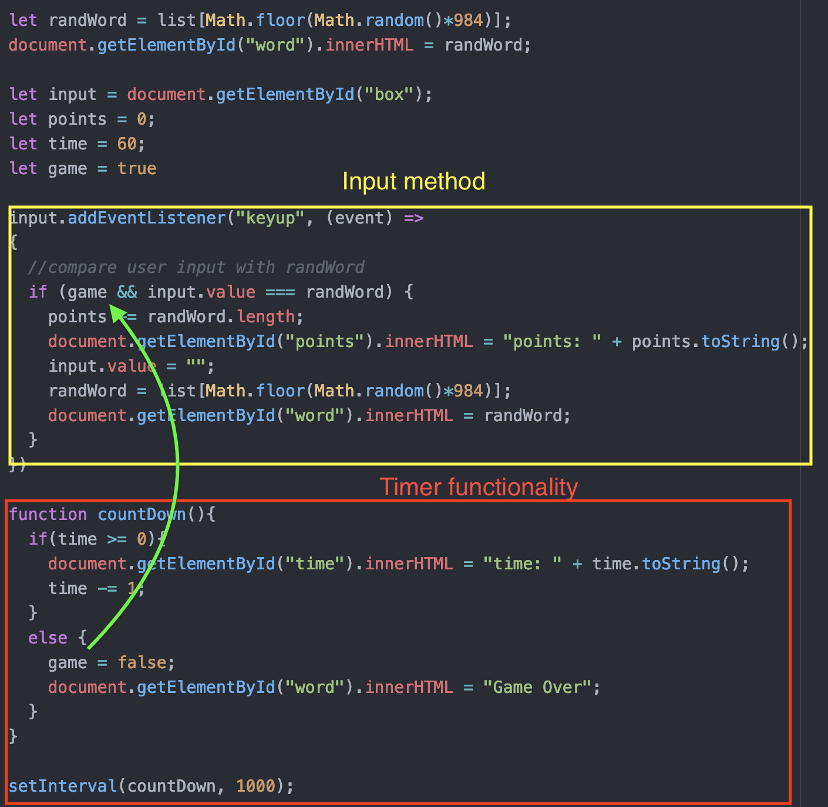
Code
Every time a key is released, the game compares the value of the input field with the target word.
Once the timer runs out, it becomes impossible to gain points.

Slide 4
Demo time
https://academic-era-247918.appspot.com

Slide 5

Summary
Shout outs
Skills gained
CSSI experience

